Slide 1

Parental Substance Use Covid 19 Resources
Kimberly Shapiro, LICSW
Substance Use Unit, Director
Kimberly.shapiro@massmail.state.ma.us
ff

Slide 2
Physical Distancing not Social Distancing
It is important to remember that physical distancing does not have to mean social distancing. Social connections are important during these times.
People in both early and long-term recovery have added challenges. The isolation created by the COVID 19 outbreak can heighten feelings of stress, worry, and anxiety. All of these feelings can trigger substance use. The social isolation, loss of routines and structure that support recovery may lead to individual to self-medicate to cope- relapse.
Families may also be experiencing an elevated level of stress due to parenting. Reach out to an individual’s family members, supports and/or treatment providers to discuss ways in which the family can have additional points of contact for support.
Notes:
As we enter week 10 of life changes due to Covid 19, families, particularly those that are marginalized by Substance Use and Mental Health Disorders,
are facing unprecedented challenges related to health, finances, and parenting. Two common themes in recovery is that “addiction is a disease of isolation” and heightened anxiety is a near universal trigger for substance use. It is difficult to think of a more stressful event, for lots of us, than this pandemic.

Slide 3
Suggestions to guide conversations with individuals and families for whom parental substance use is of concerns during COVID 19,
Know where to refer people for help. Massachusetts treatment providers are still open for help. Many programs offer on-site services, are taking precautions or providing online and telehealth services. An individual or family member can talk to a helpline specialist at 1-800-327-5050; Monday – Friday 8 am – 10 pm; Saturday and Sunday 8am – 6 pm. A specialist can direct them to who and where to access treatment. Information can also be accessed at their website www.helplinema.org.
Recognize that this is a stressful time, validate and relay that it is okay to ask for help.
  A sign of strength in any recovery journey is the ability to ask for help for both recovery and parenting.
Encourage parents/caregivers to maintain connected to their recovery supports and trusted love ones,
  Call, text, or email a trusted friend, family member or provider. Encourage them to ask for what they need.
Ensure individuals are reviewing their relapse plan.
  Typically, a person who is involved in a treatment program, have created a plan of action to avoid a setback/relapse. If a parent does not have one, a provider can support a parent to develop an appropriate plan.

Slide 4
Ensure parents have a plan for emergencies for themselves and their children. For example; if there is a relapse and/or if a parent were to become sick.
  Remind parents their own health and wellbeing continue to be an important part factor in their children’s wellbeing.
Support parents to identify online resources to supplement their plan, (see later slides and attachments)
Encourage parents to change the plan to meet any changing needs.
Help them to think about the things they can do while staying safe during social distancing. Some things to consider adding to a plan are;
  Try mindfulness as part of the day. There are many apps available.
  Start and keep a gratitude journal.
  Limit screen time.
  Be active – take a walk, stretch or do yoga.
  Watch your favorite television show or movie at home.
  Read a good book.
  Write in a journal.
Let parents know you will want to hear what strategies they have tried. Ask what worked and what didn’t. Encourage they keep trying. Additional relapse prevention resources can be found at https://helplinema.org/learn-more/treatment/recovery/relapse-prevention/

Slide 5
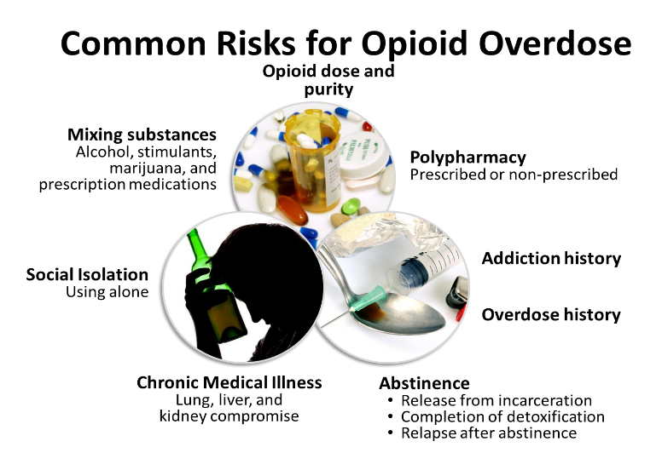
:
How to address overdose risk with families
Have upfront, honest conversations about concerns based on the risk factors.
Consider the family supports and engage them during the safety planning process
Have conversations with supports/family/providers to identify how everyone can mitigate overdose risk and the subsequent impact on the children.
Examples of how a support can participate in a Safety Plan are:
  Identify a person who can be in regular contact with the family to assess and respond to situations that place the children at risk.
  Educate families on how to obtain Narcan from pharmacies or providers.
  Discuss how children can keep themselves safe in moments of family crisis. This may not always be appropriate based on family dynamics, developmental/behavioral health challenges of the child, etc.
DPH/BSAS - Graphic
Notes:
SLIDE Common Risks for Opioid Overdose (1)
As approved trainers we need to understand the risks of opioid overdose and convey those risks to our participants. Many of the risks for opioid overdose are well established and these can be helpful in educating participants. We need to ask our participants and learn their history to understand what their risks are.
SLIDE Common Risks for Opioid Overdose (2)
Higher opioid doses, such as daily doses higher than 50 morphine milli-equivalents increases overdose risk. Also, changes in dose or formulations increase overdose risk; people who use heroin are thus frequently at risk due to unpredictable changes in substance purity from, for example, adulteration with fentanyl.
SLIDE Common Risks for Opioid Overdose (3)
Polypharmacy and mixing substances contribute to overdose risk, as opioid overdoses commonly involve other substances. Psychoactive medications of particular concern include barbiturates, stimulants, and benzodiazepines. Other medications that can have synergistically central nervous system depressive effects include clonidine, promethazine, and gabapentin, include clonidine, the blood pressure medication; promethazine, a medication an anti-nausea medication; and gabapentin.
SLIDE Common Risks for Opioid Overdose (4)
We also need to think about people who are socially isolated; whether they are using heroin or prescribed opioids they are at increased risk of dying from overdose because if and when they overdose there is no one there to rescue them. So we need to educate participants that if they are going to use opioids, someone else should be around so that they can respond if they use too much. Isolation is also associated with depression, which is itself associated with overdose
SLIDE Common Risks for Opioid Overdose (5)
We should also consider chronic medical illness, particularly diseases of lung, liver, and kidney that compromise their function. These increase the risk of overdose because they are the organs that metabolize substances and responsible for oxygenation. Also mental illness, such as depression and anxiety, increase overdose risk.
SLIDE Common Risks for Opioid Overdose (6)
Participants who've had a prior non-fatal overdose are at increased risk of having fatal overdose, similar to patients who have had suicide attempts are at increased risk for completing a suicide.
SLIDE Common Risks for Opioid Overdose (7)
Participants with a previous addiction history have increased risk, they are subject to relapse, and are therefore at increased risk of overdose.
SLIDE Common Risks for Opioid Overdose (8)
Periods of abstinence should trigger us to educate our patients about overdose. We often think of abstinence as the goal for our patients with addiction and that over the long term it really should decrease their risk of overdose, but abstinence often comes with reduced opioid tolerance, which is actually a risk for overdose. Thus, it is important that we educate participants about that. So we are particularly concerned about people who are released from incarceration and people leaving detox. We also need to think about people in recovery and who are abstinent from opioids and educate them about their increased risk if they relapse.

Slide 6
It Takes a village to raise a child!
Collaboration-with caretakers, community treatment providers, the Department, and families is crucial to providing the best outcomes possible.
Educate self- know the signs and symptoms of your loved ones.
Identify your professional and personal supports that you can turn to during a crisis.
Maintaining open communication with family members – including children in the family.
No one can do this in isolation!
No one organization or system can address all of the substance use challenges facing families and communities. Ensuring child safety and family health requires collaboration and partnerships among families, professionals, agencies, organizations and communities, (Mass Family Recovery Collaborative, 2005).

Slide 7

Effects of Recovery on Children
Children feel safe
Children have a role in the family that is within cultural norms or is age-appropriate
Children have healthy role models
Children develop healthy boundaries
Children move away from “Don’t talk, Don’t trust, Don’t feel”
Children understand that they didn’t “Cause it, Can’t cure it and Can’t control it.” Foster Parents can help reinforce this important message to kids.

Slide 10
Children Impacted by Parental Substance Use
Teen corner of Alanon
https://al-anon.org/newcomers/teen-corner-alateen/
https://cpb-us-w2.wpmucdn.com/u.osu.edu/dist/c/54108/files/2018/05/Witnessing-Overdose-Trifold-Final-22kzbeb.pdf
https://sesamestreetincommunities.org/topics/parental-addiction/
/

Slide 11
Resources
Treatment - An individual or family member can talk to a helpline specialist at 1-800-327-5050; Monday – Friday 8 am – 10 pm; Saturday and Sunday 8am – 6 pm. A specialist can direct them to who and where to access treatment. Information can also be accessed at their website www.helplinema.org.
Relapse prevention resources https://helplinema.org/learn-more/treatment/recovery/relapse-prevention/

Slide 12
Online/Phone Resources for Recovery Support, Parenting, and COVID-19
Compiled by Institute for Health and Recovery
RECOVERY SUPPORTS
The Mass. Substance Use Helpline continues to offer referrals and general information about SUD, as well as links to resources available during the COVID-19 crisis https://helplinema.org/covid-19-resources-for-ma/
Alcoholics Anonymous
AA Phone Meetings http://aaphonemeetings.org/
AA Western MA Intergroup Virtual Meetings https://westernmassaa.org/aa-meeting-schedules
AA en Espanol https://aa-intergroup.org/languages/index_es.html
AA Boston https://aaboston.org/
AA Search by State: https://www.aa.org/pages/en_US/find-aa-resources
AA Intergroup http://aa-intergroup.org/
AA Online Grouphttps://www.onlinegroupaa.org/
The Token Shop maintains a list of online meetings that is updated regularly. You can search by day and time and they include the topics of specific meetings: https://www.thetokenshop.com/Online_AA_Meetings
Pause a while Free conference calls for AA meetings at 2pm every day
Dial in number: 425-436-6360
Access Code: 422932

Slide 13
A Virtual Awakening Closed online AA meetings for women, trans, and non-binary people
Sun, Mon, Wed, Fri at 8:30pm EST, Thurs 1:00pm EST
https://zoom.us/j/4822208285
Narcotics Anonymous
New England Region of Narcotic Anonymous Virtual Meeting list: https://nerna.org/nerna-virtual-meetings/
Phone meetings: www.nabyphone.com
Global Online meetings: https://virtual-na.org/
Free NA Speaker Streaming 24-7 www.naspeaker.com
Never Alone Club Online Meetings https://www.neveraloneclub.org/
NA in Multiple Languages: https://virtual-na.org/meetings/
Cocaine Anonymous offers online support and services
https://www.ca-online.org
Recovery Speakers: Listen to recovery speakers from many different 12 step groups
www.recoveryspeakers.com
Gamblers Anonymous
Massachusetts Hotline Number: 855-2CALLGA (855-222-5542), GA virtual Meeting on In the Rooms and
hosting phone meeting every night of the week from 9:00-11:00 PM Eastern time. Phone Number 712-770-4160 –
Access Code 611704#. http://newenglandga.com/
Marijuana Anonymous
http://marijuana-anonymous.org/find-a-meeting/

Slide 14
Resources for Family Impacted by Substance Use Disorders
Al-anon Electronic meetings for anyone affected by alcoholism in a family member or friend
Al-anon.org/electronic-meetings
Allies in Recovery Online support for families dealing with a loved one’s addiction, using the evidence-based CRAFT method (Community Reinforcement and Family Training ); free for Massachusetts residents.
https://alliesinrecovery.net/
Learn to Cope
https://www.learn2cope.org/
Smart Recovery Family
Smartrecovery.org/family
FREE YOGA AND FITNESS
Phoenix Gym offers a range of FREE virtual exercise classes (meditation, yoga, CrossFit, etc. for people in recovery. Every 2 hours from 7 am - 9pm https://thephoenix.org/virtual/
Down Dog Yoga: https://www.downdogapp.com/
Trauma-informed Yoga/The Trauma Institute in Boston: https://www.traumasensitiveyoga.com/online-tctsy.html
Peloton App (offering free trial for 90 days, no bike)
Alo Yoga: https://www.youtube.com/channel/UCJEi1foUiGObzzQM3QA2H5A

