Slide 1
Family Resource Centers
AAPI Data Entry Revised June 2026

Slide 2
Role of the Administrator
Provided credentials for accessing Assessing Parenting
  Administrator shares credentials with staff person who will enter the data
Responsible for Quality Control
  Review data entry to ensure no PII is entered into the system and that the Family Member ID information is entered correctly
  Check that DOB is reflecting the month and day of the 1st assessment
  Ensure each class is entered with the correct naming convention
Will be notified if PII is being entered or if class naming convention is incorrect
  Site will be given 7 business days to correct the data. If is not corrected the data will be deleted to protect the Family Member’s information.
Website: www.https://assessingparenting.com/login

Slide 3
AAPI Data Entry – Class Naming Convention
Naming convention for the program (classes)
  Each EVB Parenting series that runs needs to have its own program. Below are samples of how the classes should be listed in the Assessing Parenting database.
    Ex: Nurturing Fathers In-Person Feb – Mar 2022
    Ex: Nurturing Fathers Virtual Feb 2022 – Mar 2022
    Ex: Parenting Journey 1 Hybrid Sept 15 2022 – Nov 30 2022
Do not name the Program as your FRC. Each class should be identified separately as described above.
  The evaluation team does a cross walk with the data in the CRM. They pull the CRM data on EVB Parenting classes and look at the class, if the AAPI indicators are entered, and if the Family Member graduated.
The AAPI is used for the following programs:
  Nurturing Families Classes, Parenting Journey Classes, and Active Parenting Classes

Slide 4
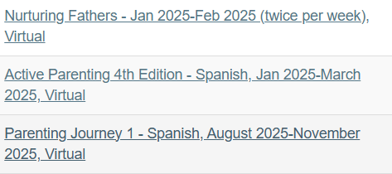
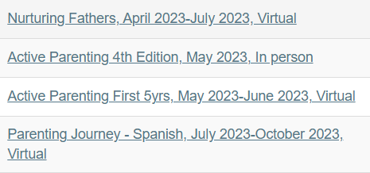
Correct Naming Convention
Correct Naming Conventions

Slide 5
Entering Family Member Data in Assessing Parenting
Absolutely NO PII should be entered into the assessing parenting website, this means the name of the family member and their date of birth.
Entering the participants information:
  Use the Family Member’s ID for name. It can be entered once in the first name field: Ex. MBR1234
Entering the participants date of birth (DOB):
  For the DOB enter the month and day that the 1st assessment took place and enter the actual birth year of the family member
  Ex. If the assessment took place today (6/23/2026) enter 6/23/1983 today’s month, day, and the family member’s actual birth year.

Slide 6

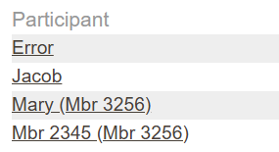
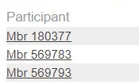

Personally Identifying Information (PII)
What is PII in terms of AAPI Data Entry?
  Name (even if it is just the Family Member’s first or last name)
  All Date except the birth year
Correct Data Entry of ID
Incorrect Data Entry of ID
First and Last Name

Slide 7
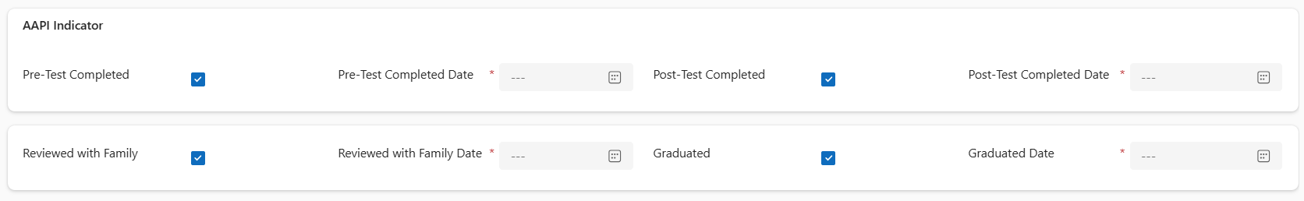
AAPI Data Entry in the CRM

